Slide 1



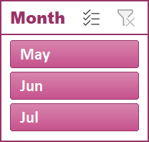


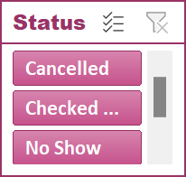
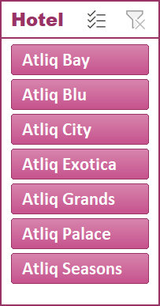
Hospitality Dashboard
Booking Analysis
Revenue
Analysis
135K
Booking
25%
Cancellation
1.5
Avg Rating
58%
occupancy

Slide 2

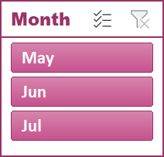
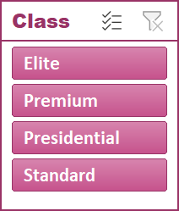
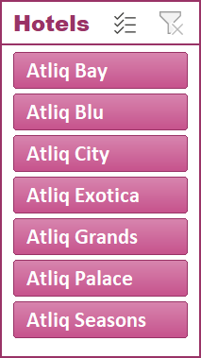
Hospitality Dashboard
Revenue Analysis
1.71B
Revenue
1.5
Avg Rating
7K
RevPAR

